Slide 1

25-01-2024 | Git training advanced | Wilbert van Dolleweerd
Notes:
Mijn rol binnen ICT toelichten.
- Vragen of installeren en configureren gelukt is.
Voorstelrondje met te beantwoorden vragen: Wat is de huidige ervaring met Git en vanuit je rol: wat verwacht men van deze cursus?

Slide 2

Version 0.0.2
Notes:
Voorstelrondje:
Wie ben je? Wat doe je? Wat doe je normaliter met Git?
Exercise:
Op het bord schrijven wat de kandidaten hopen te leren.

Slide 3
Git and project structures
My rule*: “Anything that can be considered to have a specific life-cycle, should have its own repository.”
Discussion: how would you use Git repositories to maintain the following projects?
A monolith (a single project)
A monolith using a database where the scripts are maintained by a third party
A micro-service architecture with several independent services
A web front-end with an independent backend REST API
A monolith with a library that you want to share in the future
*: My rules are more like guidelines.
Notes:
Exercise:
Tekenen van git repositories voor projecten

Slide 4
Working with multiple projects
For example: working on a project while simultaneously also developing a shared library that you want to re-use later. How would you do this?
Can be solved in different ways:
Using your architecture. Publish your library as a (Nuget) package and consume it from your application. Your application is contained in a separate Git repository as well as your library.
Cons: might be cumbersome while the library is still in development (and your application is driving that development).
Using Git Submodules to add a source dependency in your application.
Cons: No longer recommended, so will not be discussed in detail.
Using Git Subtree. Similar in functionality to submodules but more recent and with less steps.

Slide 5
Git subtree
Using another Git repository as a source dependency. Steps:
Add the dependency as a remote git remote add [remote_name] [location of git repository]
Use subtree to add it as a dependency using the remote name git subtree add --prefix [folder where to store the dependency] [remote_name] main -- squash
When necessary, update the subtree with changes from the remote git subtree pull --prefix [folder where to store the dependency] [remote_name] main –squash
Pushing changes back into the dependency:
Make a change in the dependency folder and add it to the repository
Push changes back into the remote (make sure that you have sufficient rights) git subtree push --prefix=[folder where the dependency is stored] [remote_name] main
Notes:
Create a new empty Git repository with one commit (lege .gitignore)
Clone the aspnet.core repository to a new local, bare repository. git clone https://github.com/dotnet/aspnetcore.git --bare
Add aspnetcore repository as a new remote.
git remote add aspnetcore ..\aspnetcore.git\
Git subtree initialiseren
git subtree add --prefix dependency aspnetcore main –squash
Wijziging terug pushen:
- Wijziging aanbrengen in file
- Via git add toevoegen (kan gewoon in de root van het project)
- git subtree push --prefix=dependency aspnetcore main

Slide 6
Use the SHA to your advantage
The SHA (hash) uniquely identifies a commit. You can use this to your advantage in your software.
Add a HTTP header to your REST API with the SHA
Inject the SHA into your application to be shown in a help/about dialog
(.NET) Update your AssemblyInfo files with the SHA so it is injected into your assemblies (and visible using the file browser)
Print the SHA in the beginning of your technical log file when starting your application
This gives you the possibility to remotely query what version is installed at a customers location (you can thank me later).
You can use a tool like GitVersion to extract this information from your Git repository in your build process. GitVersion started as a .NET tool but is available for multiple platforms.

Slide 7
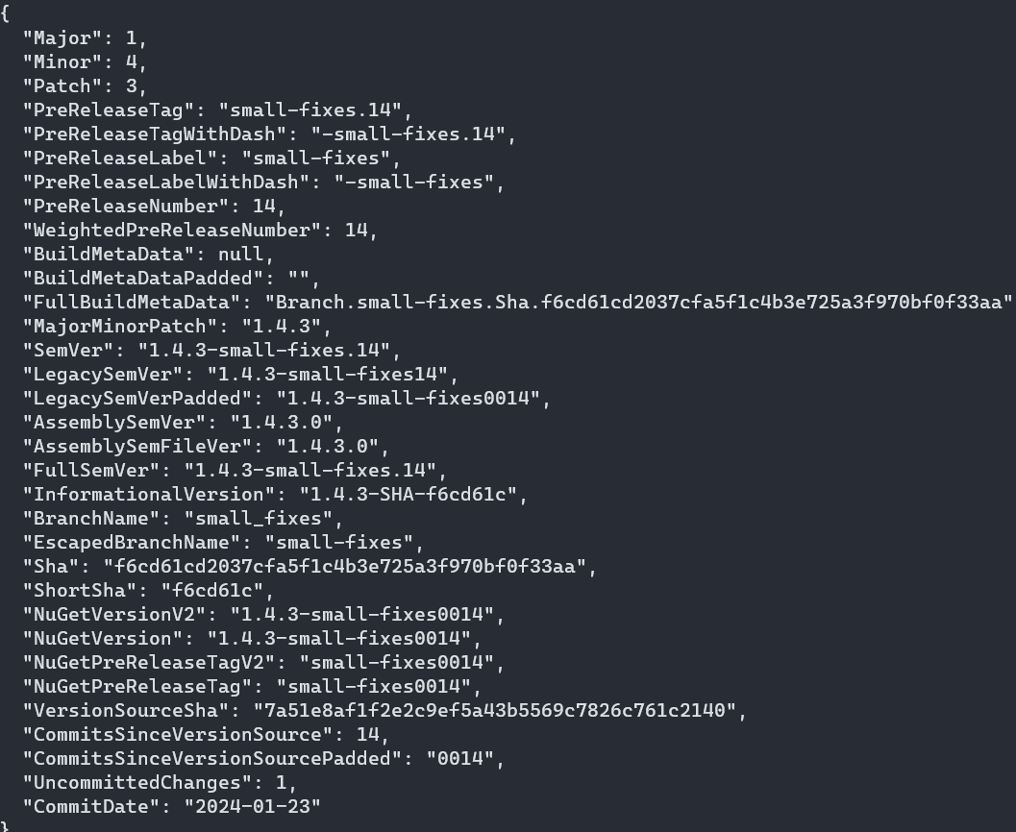
But GitVersion does so much more!
Generates a Semantic Version Number based on your Git history.
You can use this to:
Rebuilding tags always produces the same version
Not duplicating version information in multiple places (branch release/2.0.0 already has the version in it, why do I need to change something else)
Each branch calculates its SemVer and versions flow between branches when they are merged
Pull requests produce unique pre-release version numbers
Build server integration
For a complete article on how you can use GitVersion, look here.
Notes:
Use Gitversion to show the output.
Show GitVersion usage in Surfix.

Slide 8
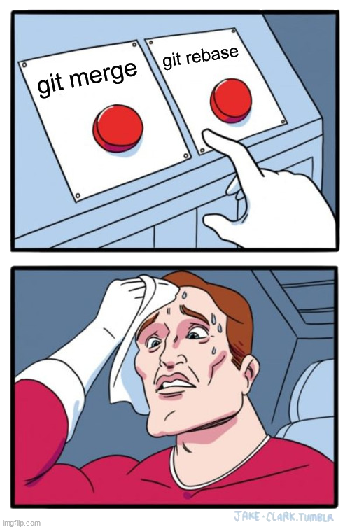
The eternal debate
Your opinion? And why?
Notes:
Merge into, rebase onto

Slide 9
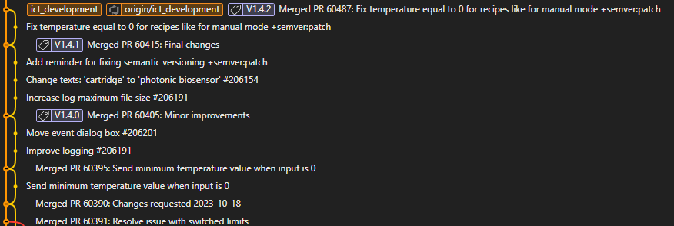
Why not use both?
Rebase your feature branch
Merge the rebased feature branch to main using git merge --no—ff
This will result in creating an (empty) merge commit linking both branches together
Screwed up the merge? Use either:
Git reset
git revert -m 1 <merge-commit-hash>

Slide 10
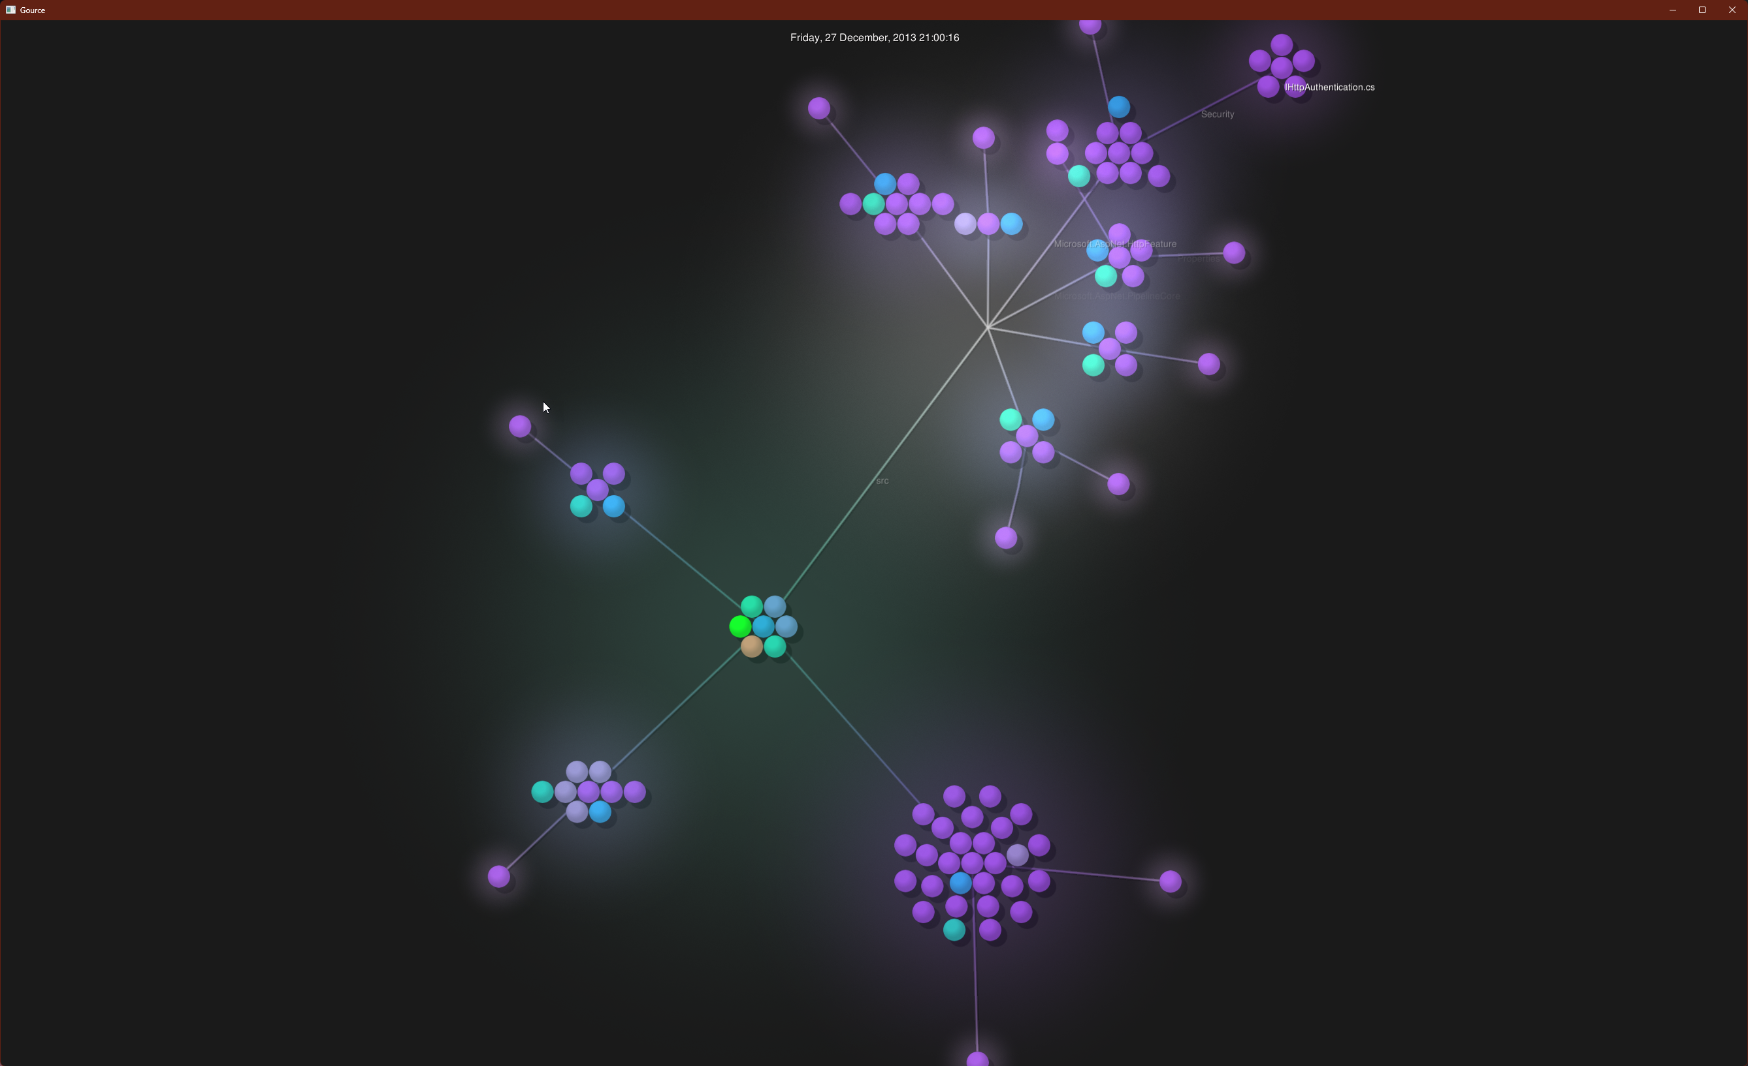
Fun stuff – visualize your git activity
Using https://gource.io/
Notes:
gource --seconds-per-day 1 [repository folder]

Slide 11
Useful Git commands
Your log in graphical ASCII format git log --graph --decorate –oneline
Search your files for a commit with a given string git log -S "A promise in JavaScript is very similar“
Find your most active contributors git shortlog –ns
Grep within git https://www.kosli.com/blog/git-grep-like-a-pro-the-complete-guide/
Git restore (git restore --<sha> somefile.py) Instead of using git reset to achieve the same.
Git switch instead of git checkout <branchname>
Git worktree to work on multiple branches in different folders git worktree add -b hotfix ./hotfix master
Create a secondary branch as backup against rebases
Notes:
gource --seconds-per-day 1 [repository folder]

Slide 12
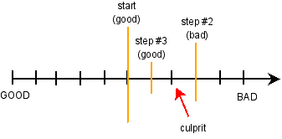
Git bisect – let Git find that bug for you
You discover a bug that has been in your code since a month. How are you going to find which commit introduced this bug?
- Let Git do a binary search for you

Slide 13
Git bisect – how to use
Tell Git when the bug was present and when it is not. (git bisect start <bad> <good>)
After each search by Git, tell it if it is bad or good until the offending commit is found.
Requires good commits (compiles and runs preferably)
Notes:
Demo geven
Aangeven dat v1.0 goed is. HEAD is slecht.
Commando’s:
Git checkout v1.0. Daarna run.cmd draaien.
Git checkout master. Daarna run.cmd draaien
- Git bisect start
- Git bisect bad (current head)
- Git bisect good v1.0
Daarna continue git bisect bad/good draaien totdat je bij de commit komt die dit geintroduceerd heeft.
Via gitk –all laten zien waar je zit.

Slide 14

Tooling to rewrite your Git repositories
From oldest (no longer recommended) to newest:
git filterbranch command. Built-in but takes ages to run.
Custom tool (Java executable) BFG Repo-cleaner
Custom tool (Python script) git-filter-repo
Destructive operation - will rewrite your history so afterwards your users will need to clone this new repository.
Foo
Folder structure:
Foo
Bar
Bar
Notes:
Tonen hoe we BFG Repo-cleaner kunnen gebruiken.
Download the JAR file op https://rtyley.github.io/bfg-repo-cleaner/
Commandline opties laten zien via ‘java –jar bfg.jar’
Demo met: java -jar bfg.jar --delete-folders .azure .\bfgtest\
Uitleggen dat wijzigingen in HEAD niet aangeraakt worden.

Slide 15
Reference material
How Git works - https://wizardzines.com/zines/git/ Best 12 euros you will ever spend

